Slide 1
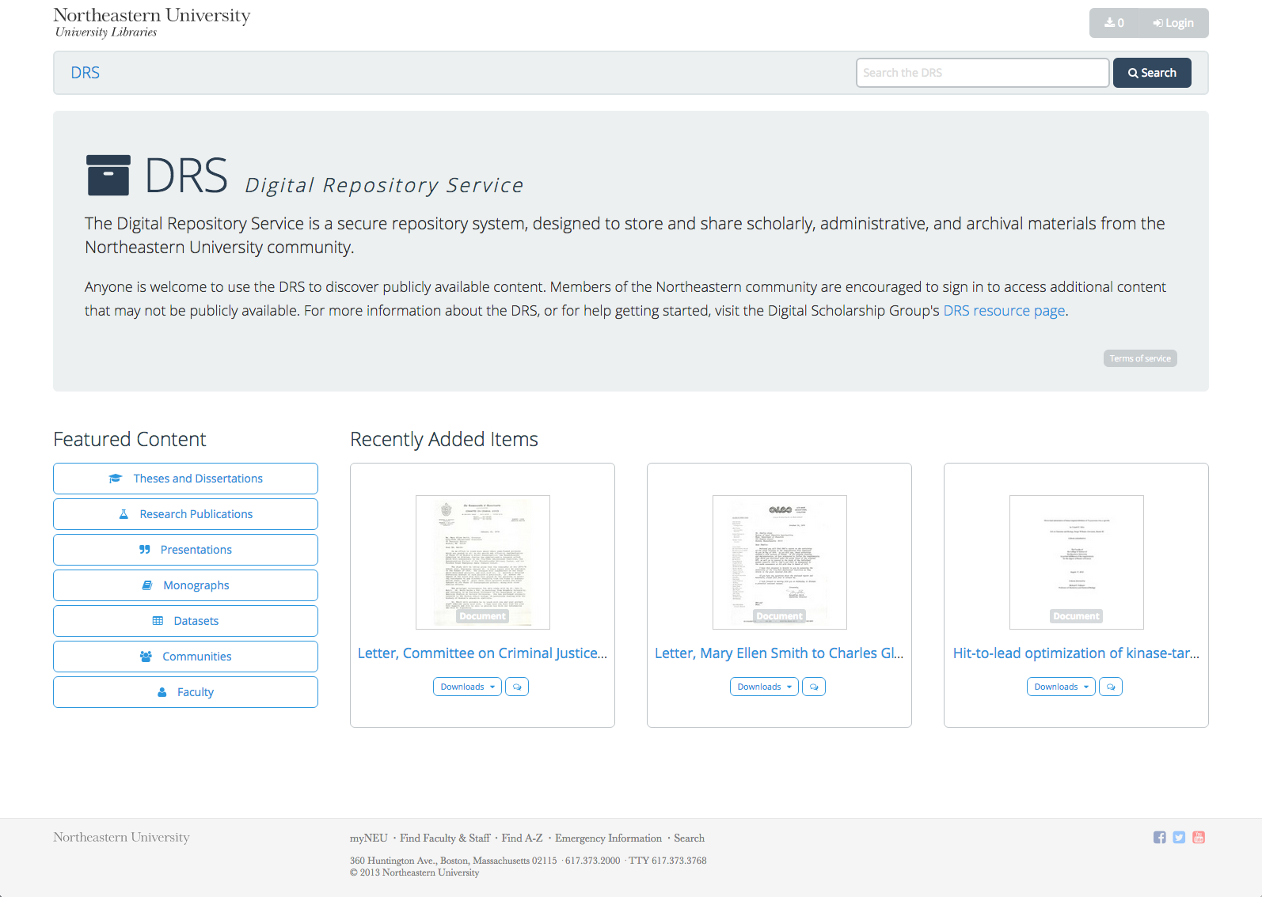
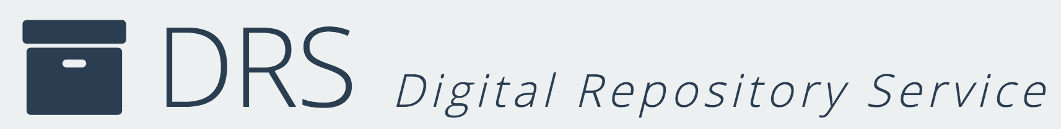
Sarah Sweeney
Digital Repository Manager
Northeastern University Library
repository.library.northeastern.edu
Notes:
Promotional Slide

Slide 2
History
Mid – late 2000’s: Various proprietary repos
2010: Beta Fedora Repo: repository.neu.edu
Summer 2013: Development begins on a new Fedora repo with a Hydra interface
Fall 2014: Soft launch to faculty and staff
January 2014: Informal usability testing
Spring 2015: Full launch to internal and external users

Slide 3
DRS Goals and User Population
Goals
To secure content created by the Northeastern community
To allow faculty to easily deposit materials
To widely share the scholarly, administrative, and archival materials stored in the DRS
User Population

